Slide 1
Ulat Ukol sa
Industriya at PCC

Slide 2
OUTLINE OF PRESENTATION
DA's Direction and Major Objectives
PCC Program and Services
Carabao Situation Report
Highlights: PCC

Slide 3
Gawain at Layunin ng DA
Carabao: draft, meat, milk and hide
draft - P500-800 per work day
Meat - P30 daily from weight gain
Milk - P200 daily from 4 liters of milk

Slide 5
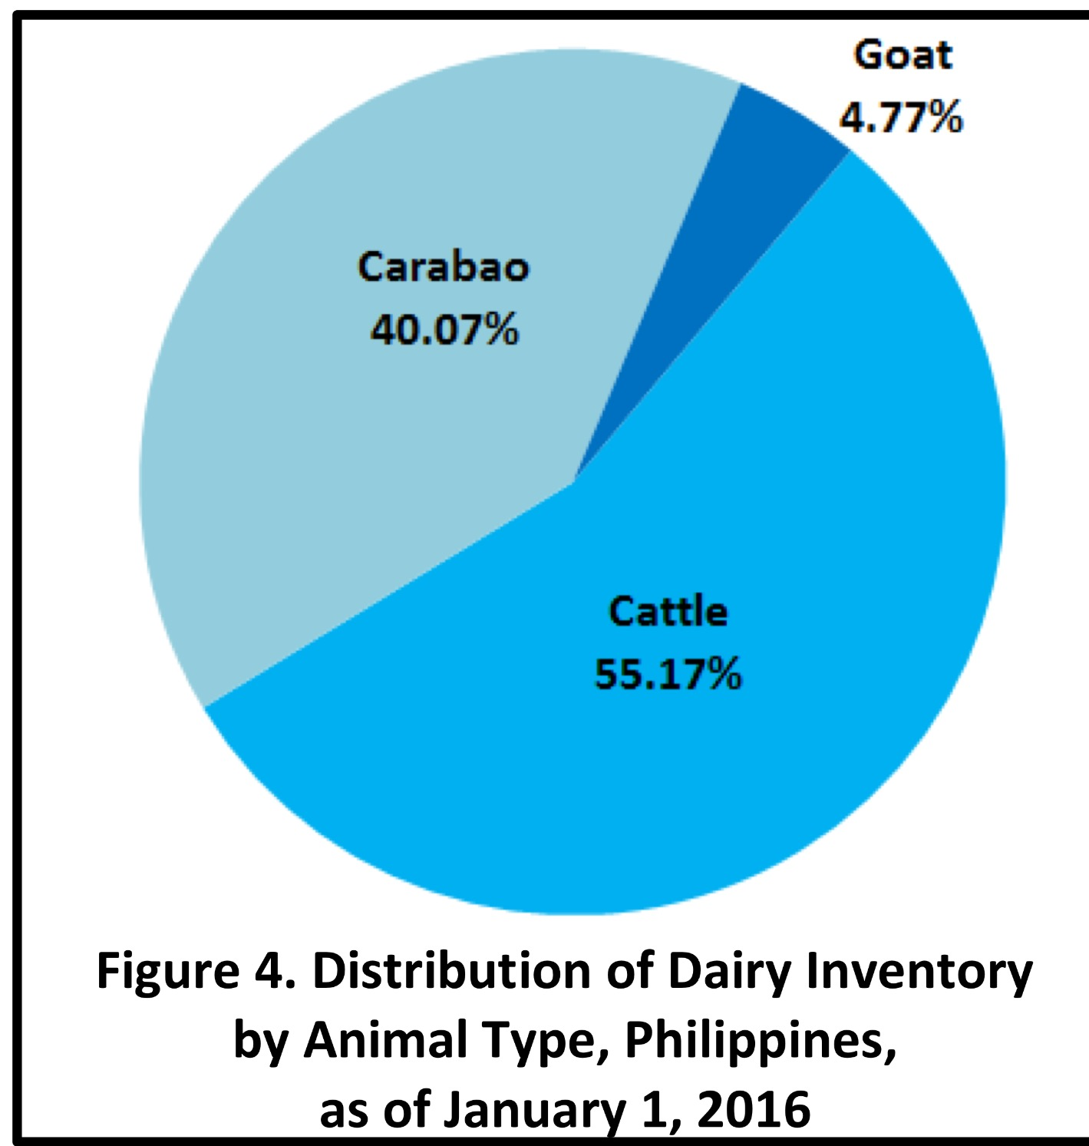
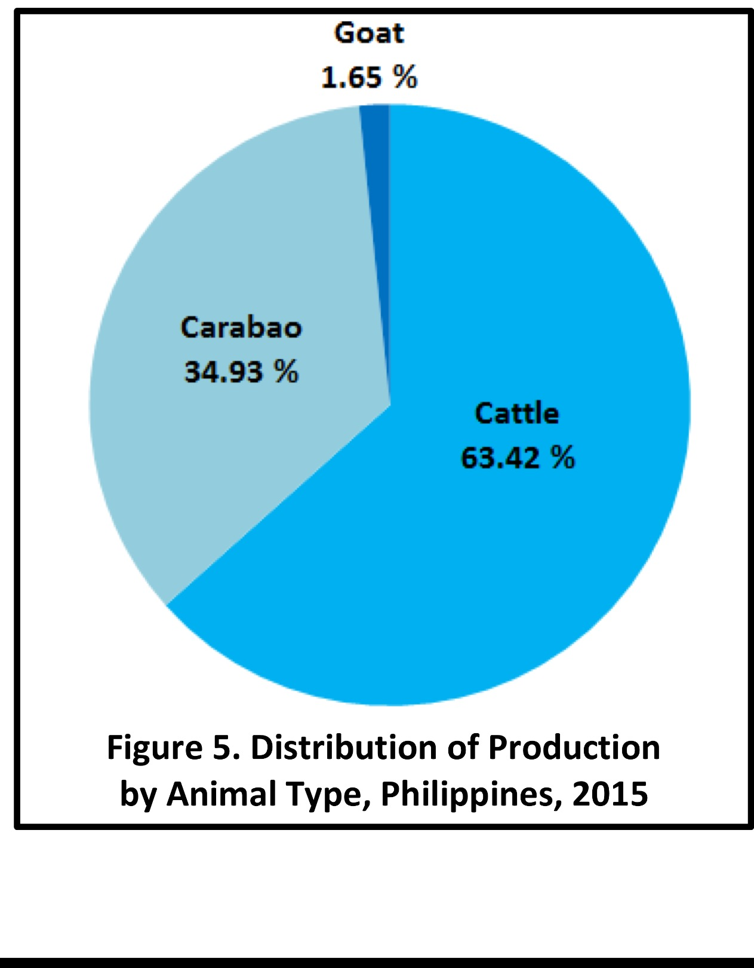
Increased share of dairy buffalo and milk produced in local production - indicating sustainability
Cattle - 24,512 hd
carabao -17,802 hd
Goat - 2,118 hd
Cattle - 12,928,000 Liters
Carabao -7,121,800 Liters
Goat - 335,000 Liters

Slide 6
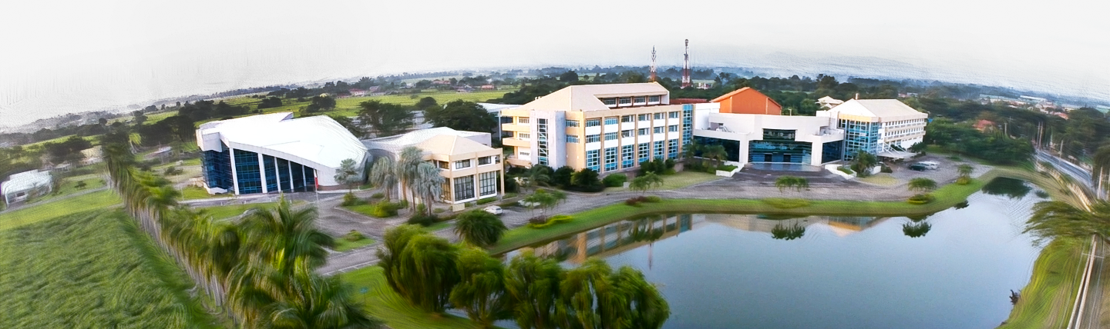
VISION To become a premier institution promoting profitable and sustainable carabao-based enterprises designed to improve the income and nutrition of rural farming communities.
MISSION
Improve the general well-being of rural farming communities through carabao genetic improvement, technology development and dissemination, and establishment of carabao based enterprises, thus ensuring higher income and better nutrition.

Slide 7
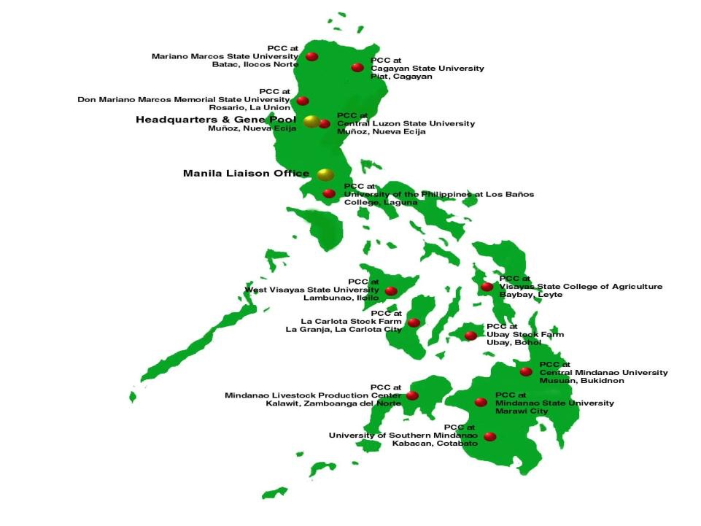
Each Center has:
Gene Pool = 25 to 400 hd
Dairy Zone = community-
based dairy program with
100 to 500 dairy animals
Research facility
Program implementation

Slide 8
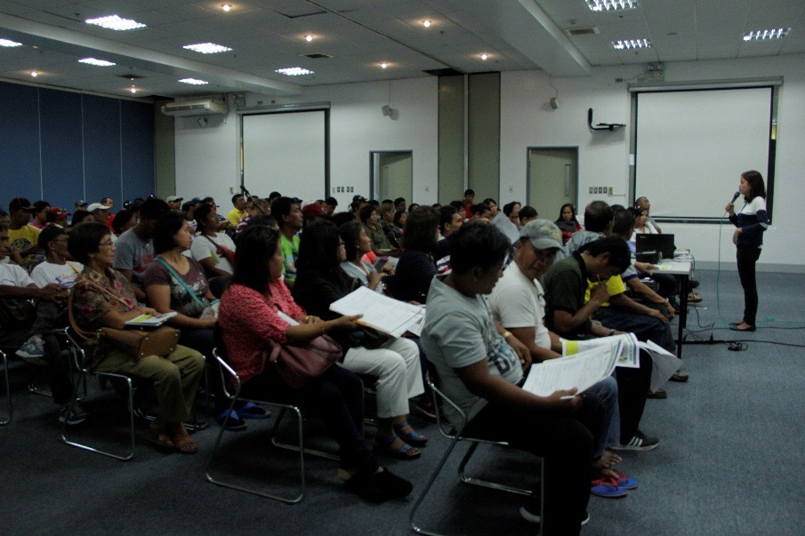
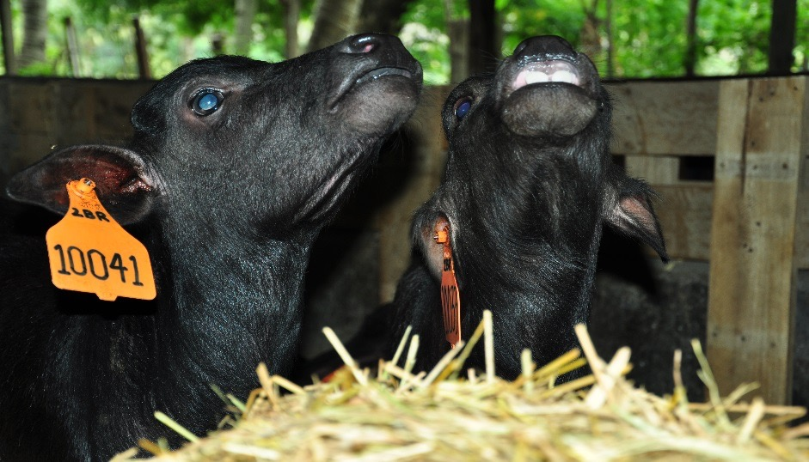
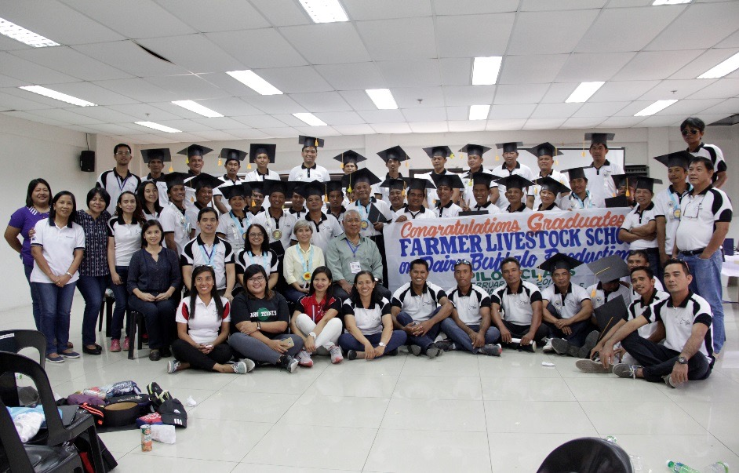
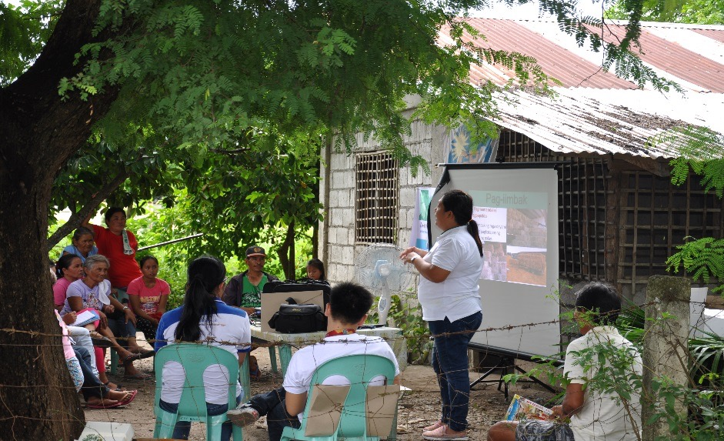
What are the services of PCC?
The PCC promotes carabao development by carrying out the following activities and services:
Development and production of genetically superior germplasm for enhanced and sustained genetic improvement
Conduct of Training for technicians and farmers

Slide 9
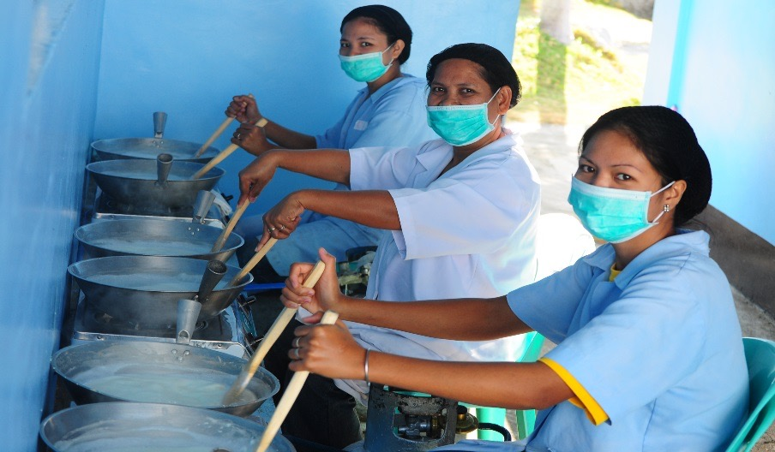
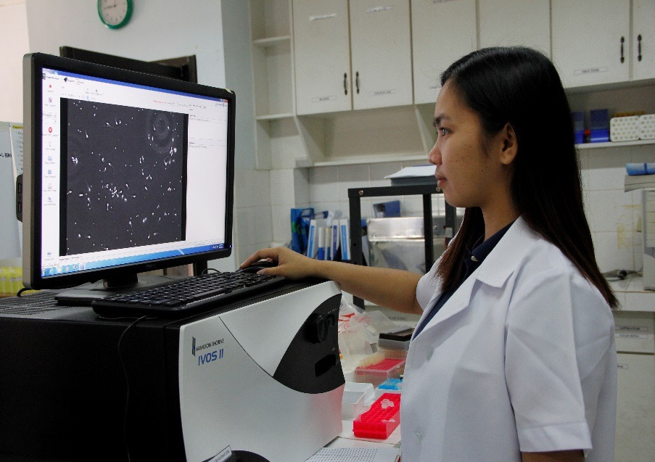
What are the services of PCC?
The PCC promotes carabao development by carrying out the following activities and services:
Assistance for the development of carabao-based enterprises
Development of technologies and assistance in policy assessment and formulation leading to a more productive carabao industry

Slide 10
(ALL PARTNERS)

Slide 11
Highlights

Slide 12
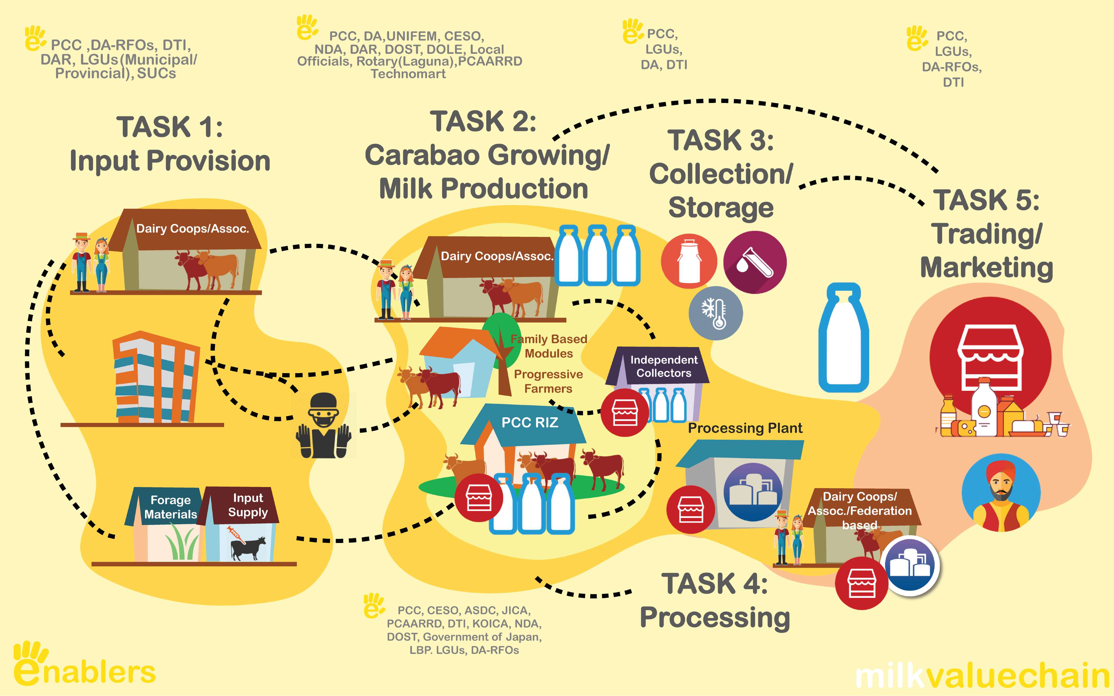
Completed: CARABAO VALUE CHAIN

Slide 13
CARABAO MEAT VALUE CHAIN

Slide 14
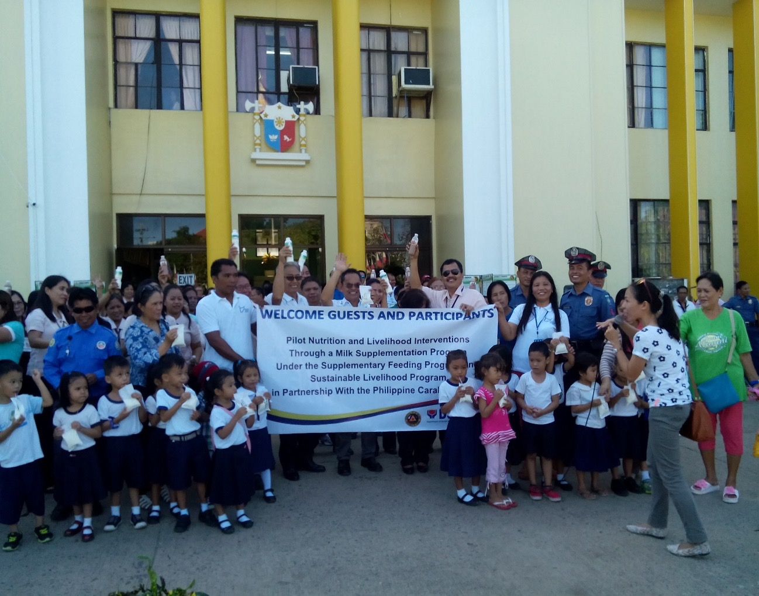
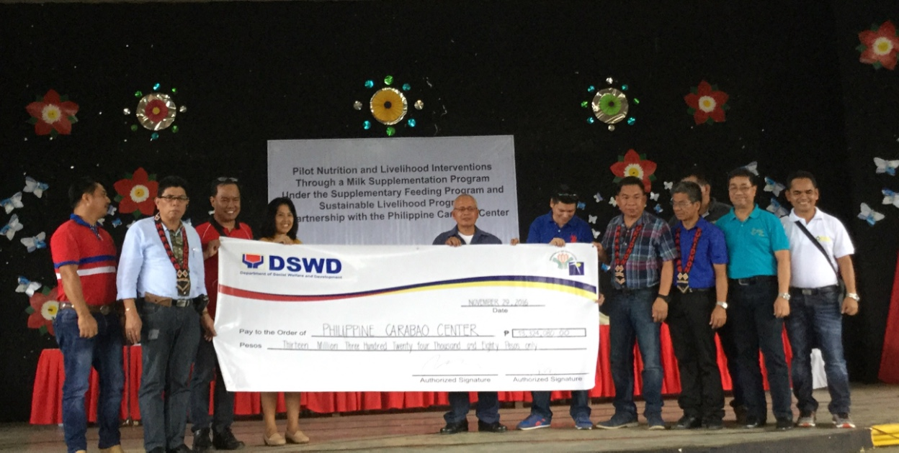
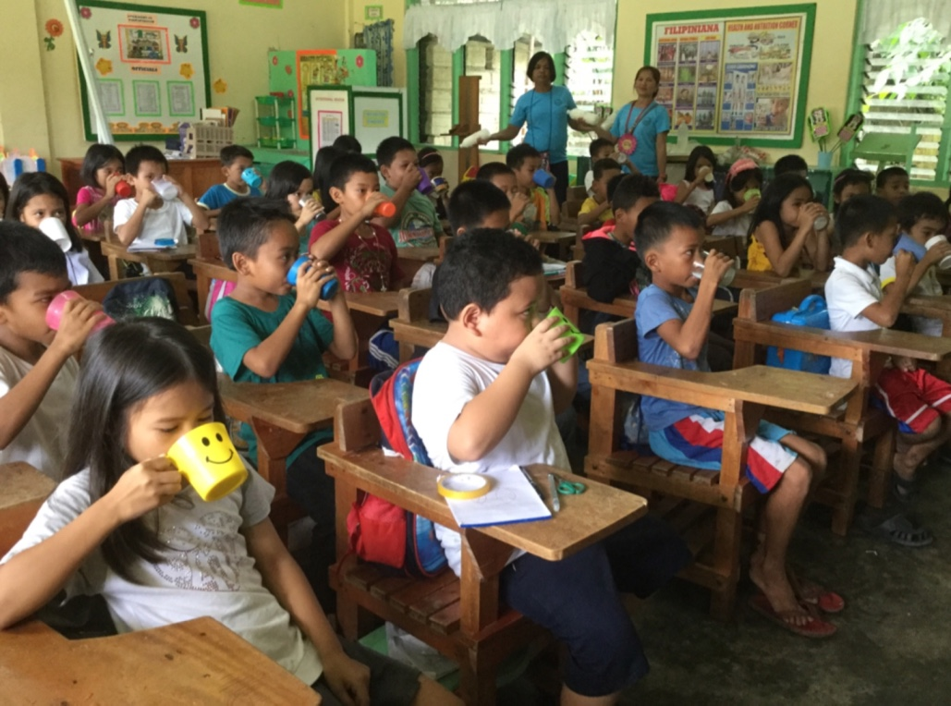
CREATING PARTNERSHIP TO ADDRESS POVERTY OF THE FARMERS AND MALNUTRITION OF THE CHILDREN: PSB-DSWD
Creating Partnerships:
PCC-DSWD-LGU milk
supplementation program
for 10,094 children in
Regions 3,7 and 10 from
Nov 2016 to June 2017

Slide 15
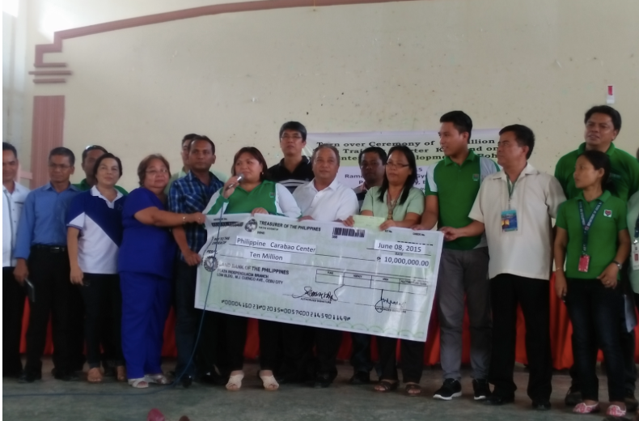
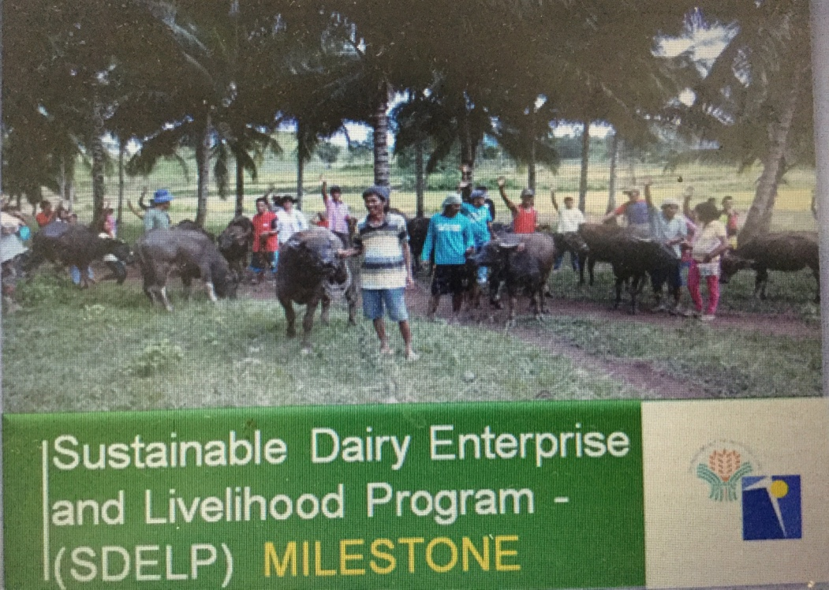
CREATING PARTNERSHIP TO ADDRESS POVERTY OF THE FARMERS AND MALNUTRITION OF THE CHILDREN: SLP -DSWD
Purchase of 500 carabaos in Bohol
Purchase of 33 carabaos for Batac and Solsona, Ilocos Norte

Slide 16
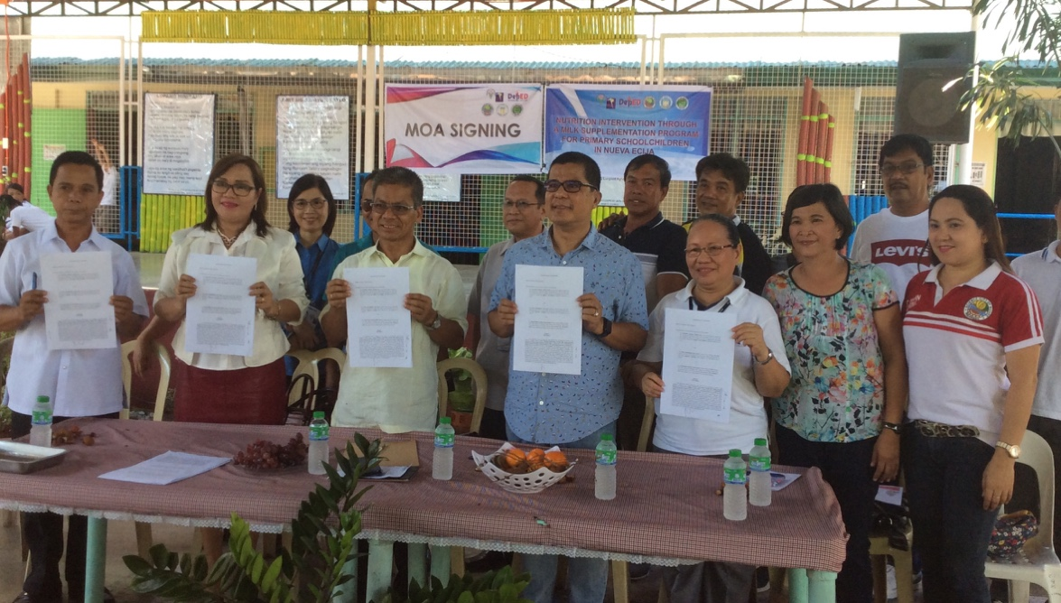
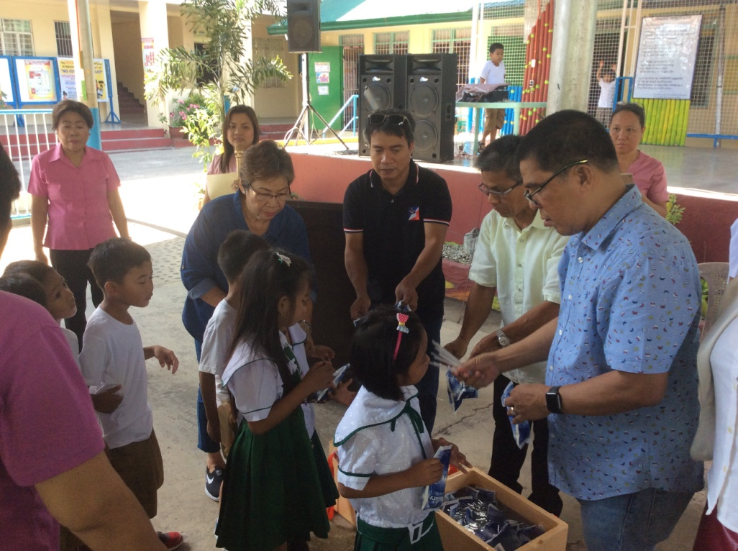
MILK SUPPLEMENTATION PROGRAM FOR GRADE 1 STUDENTS
2,000 CHILDREN IN GRADE 1

Slide 17
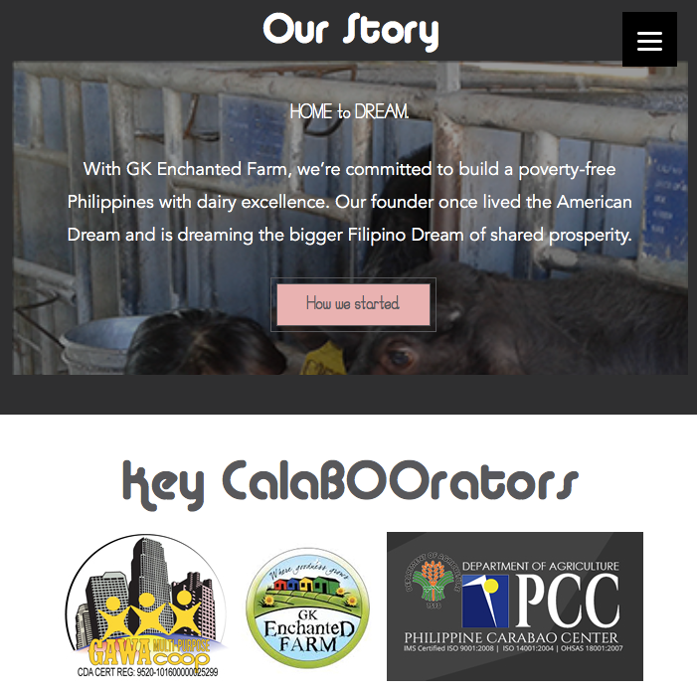
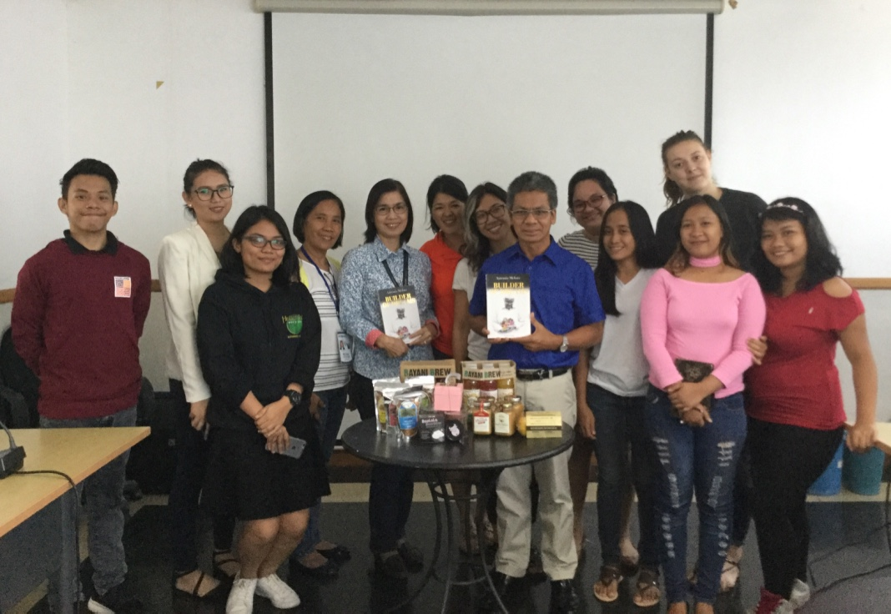
CREATING PARTNERSHIPS: GK FOR SOCIAL ENTREPRENEURSHIPS
GIVING PREMIUM PRICE FOR THE POOR

Slide 18
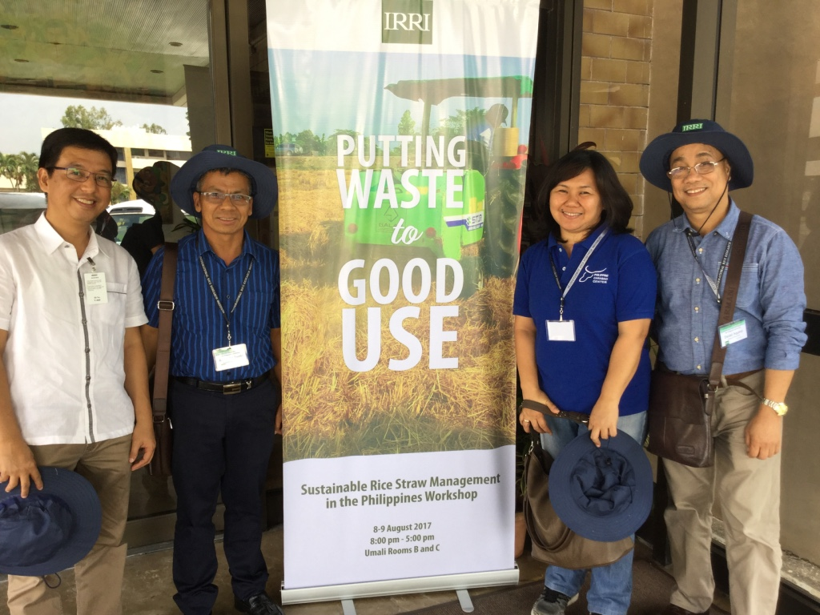
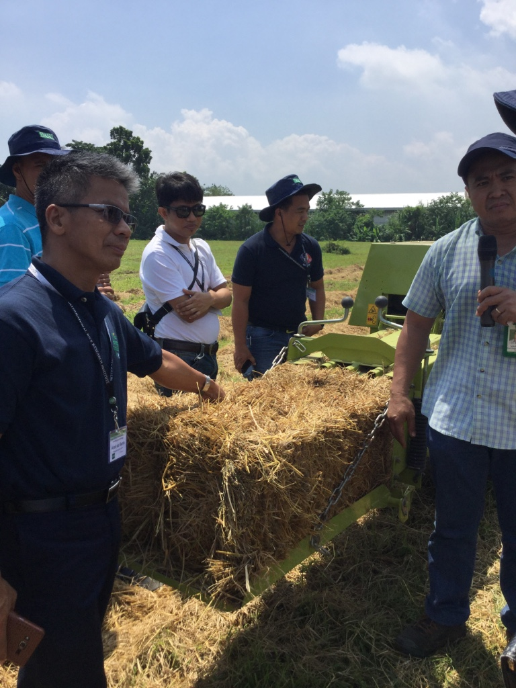
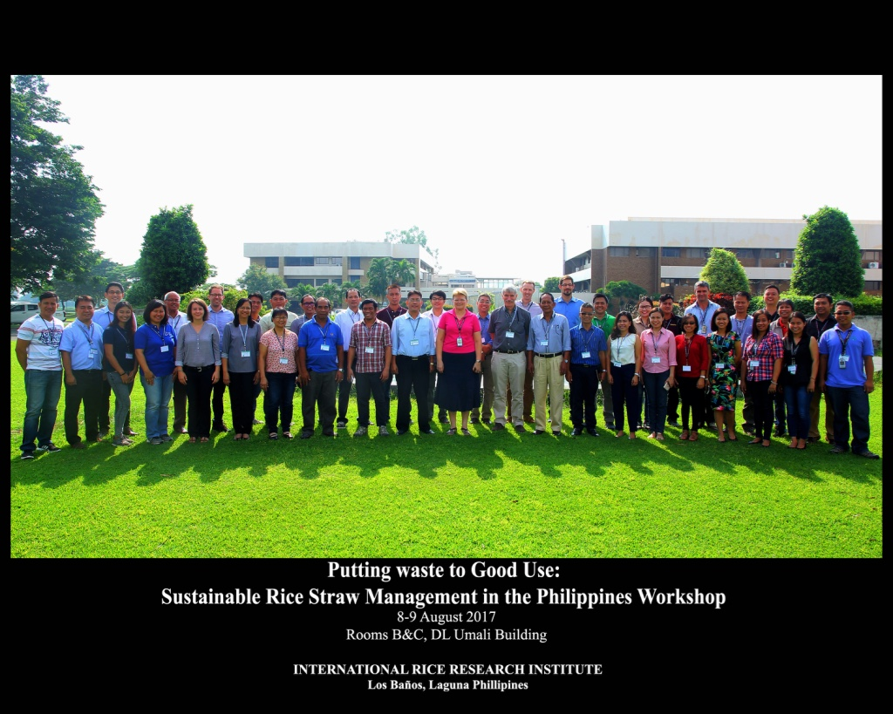
Partnership towards Sustainable Use of Rice Straw
IRRI, PHILRICE,
PCC

Slide 19
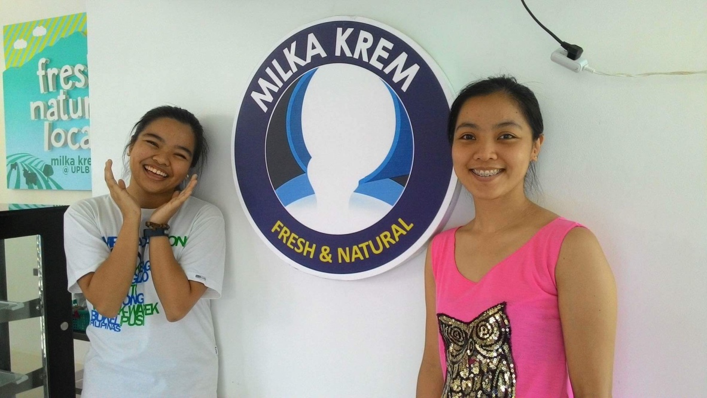
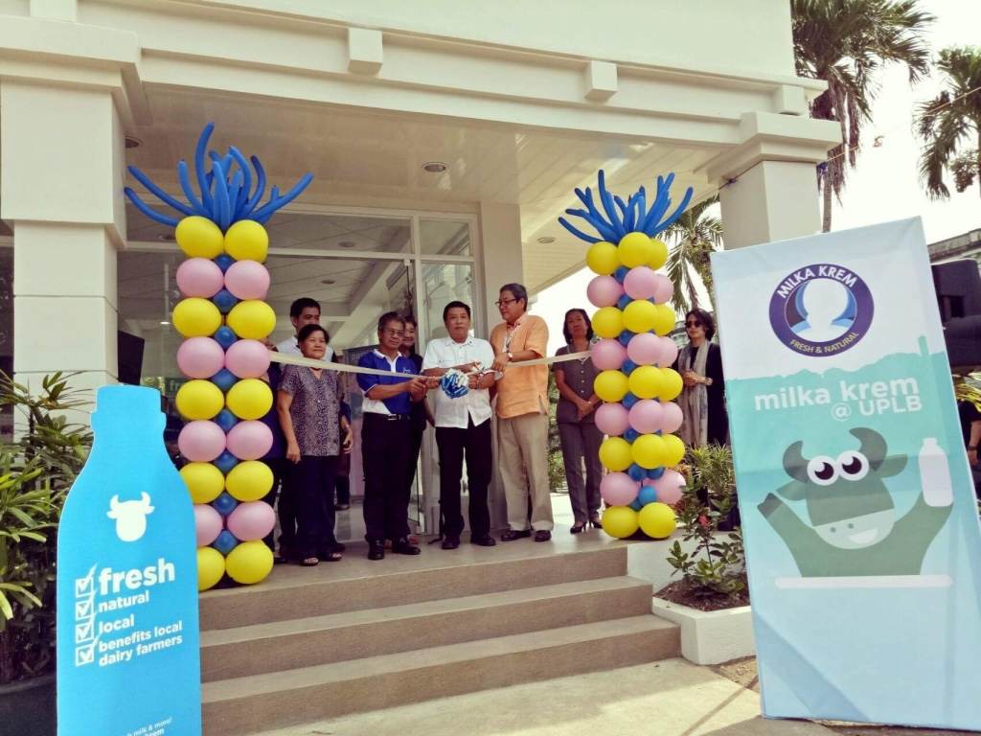
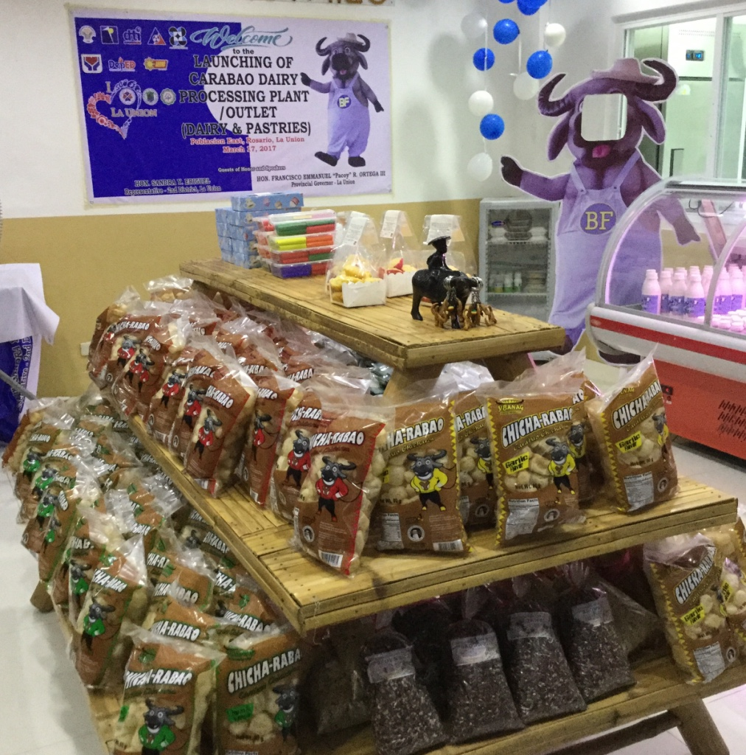
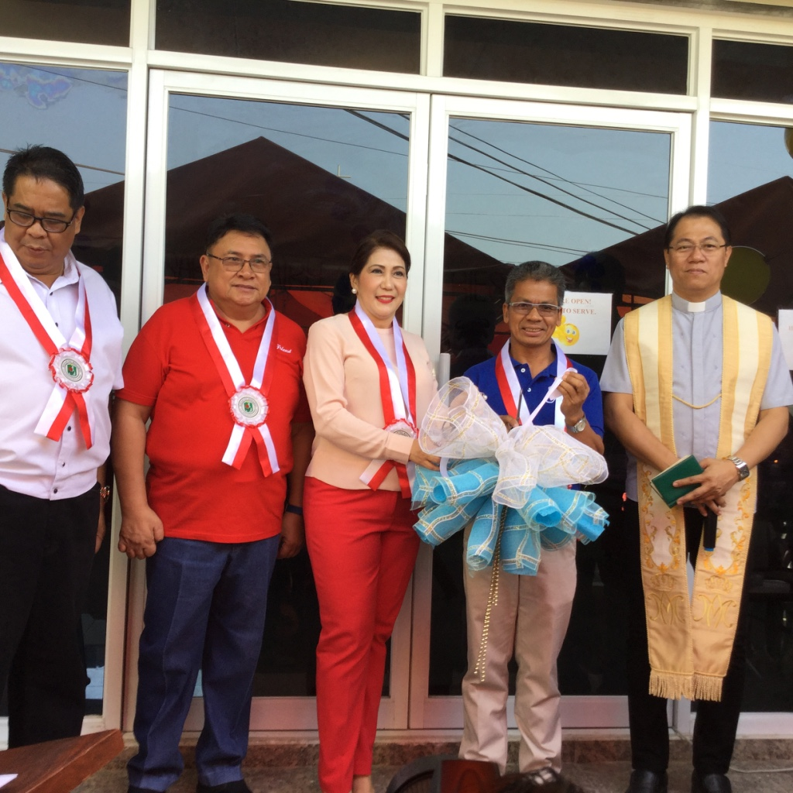
CREATING SUSTAINABLE MARKETS
MILKA KREM at UPLB
ROSARIO DAIRY AND PASTRIES

Slide 20
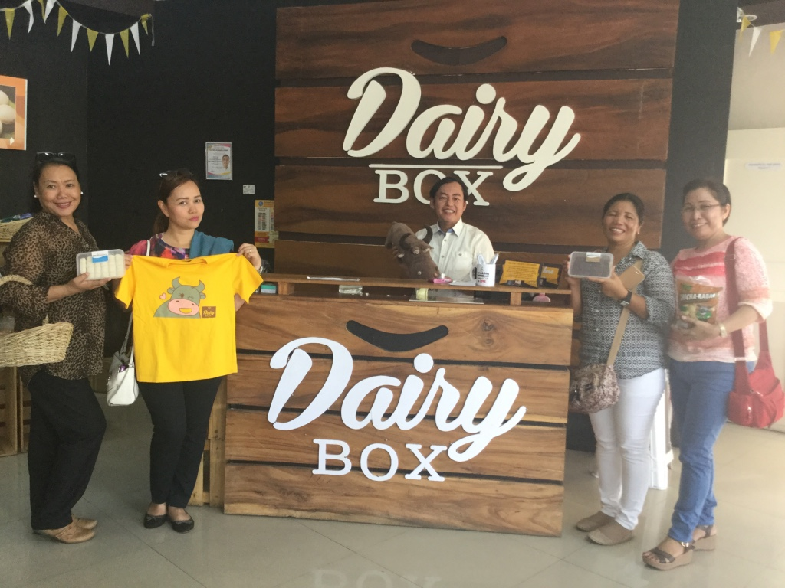
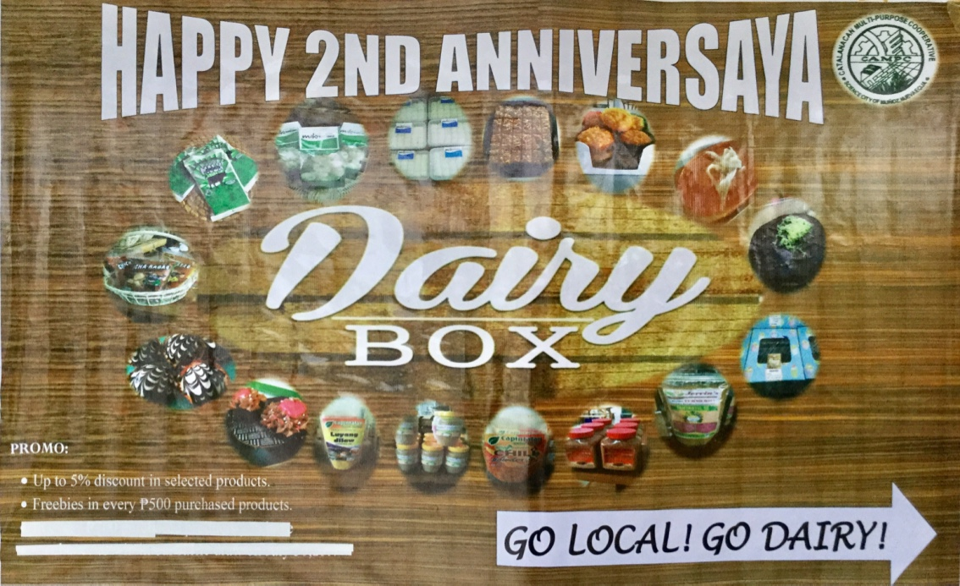
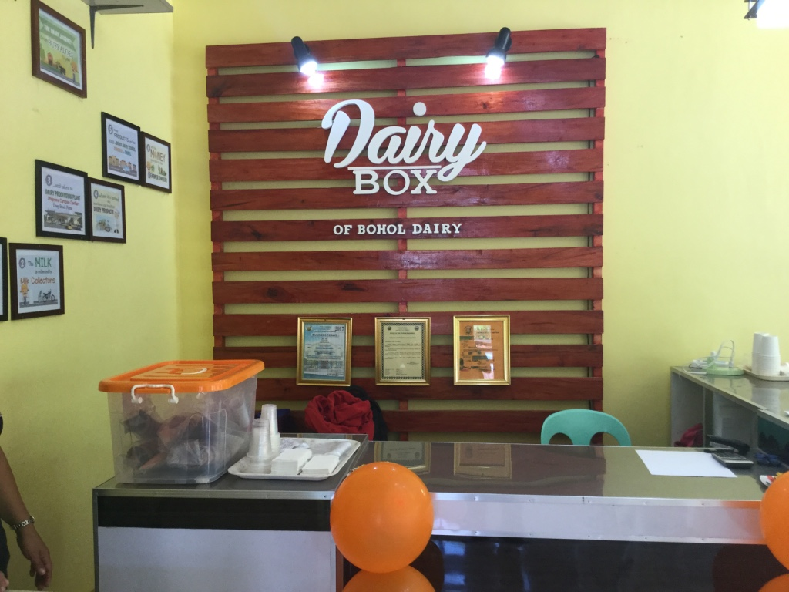
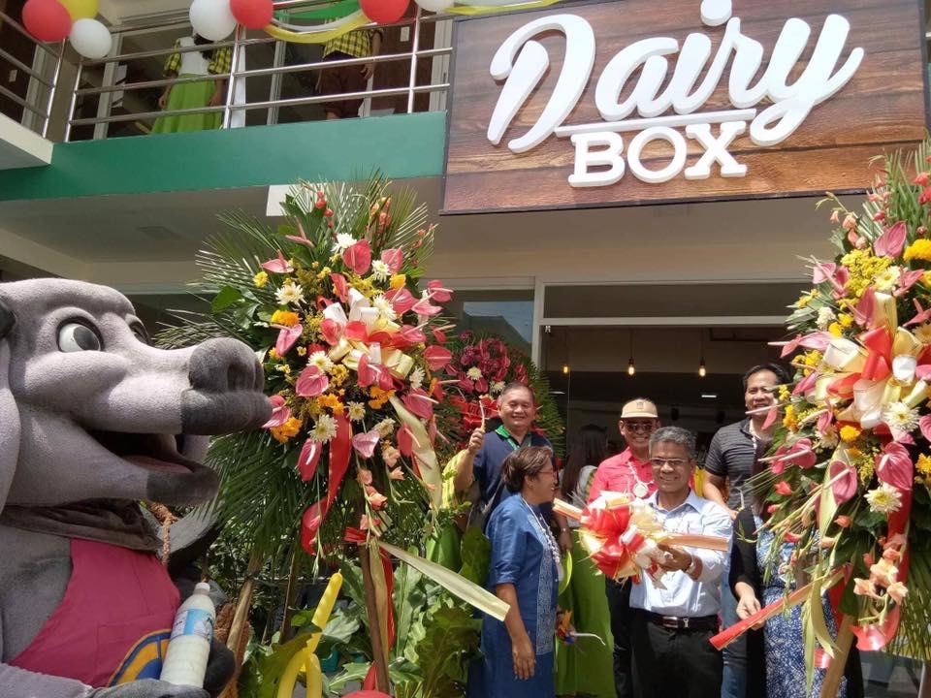
CREATING SUSTAINABLE MARKETS
Dairy Box
at Milka,
July 2015
Dairy Box at Bohol, Aug. 17
Dairy Box at Cebu, Oct. 8

Slide 21
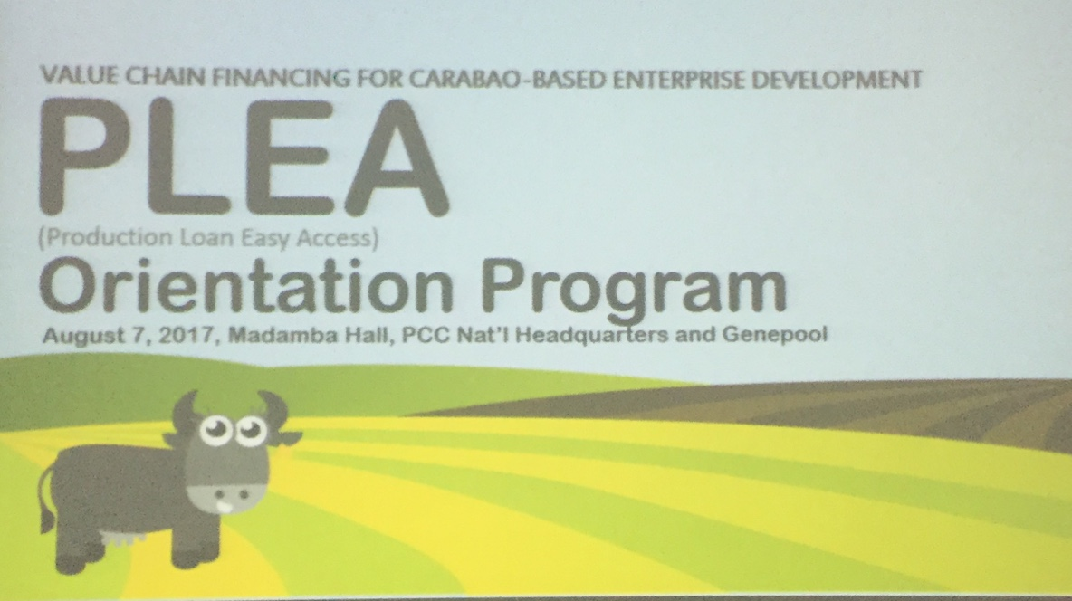
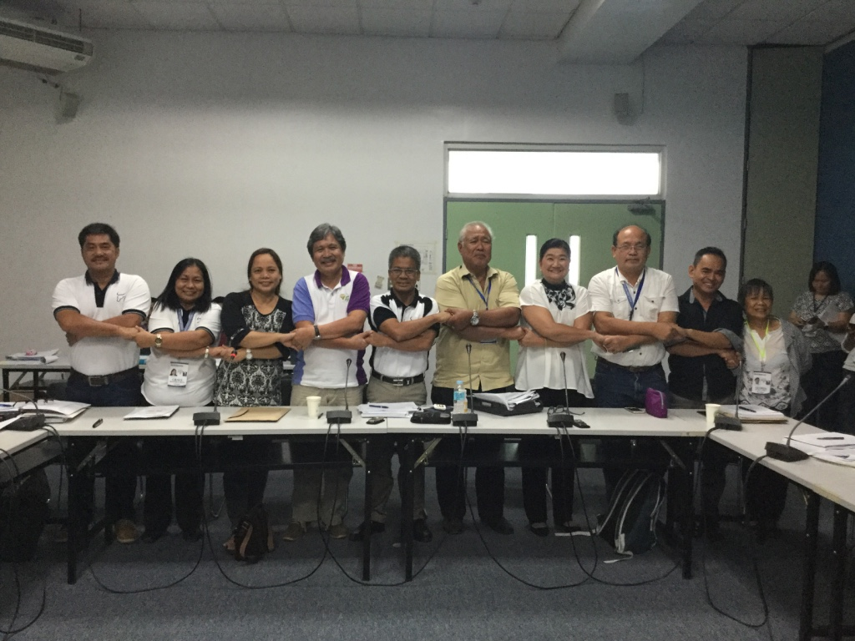
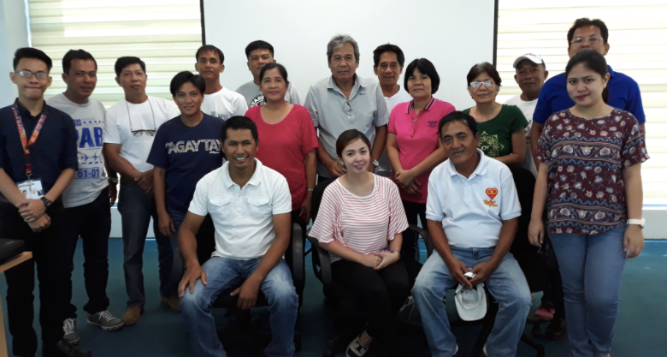
PROVIDING CREDIT WINDOW FOR CBED
THRU ACPC, P100M was budgetted for Production Loan Easy Access
4 coops (SIPBU, Eastern, Pulong Buli, Parcotela) now are implementing, with 119 borrowers, worth P5.8M

Slide 22
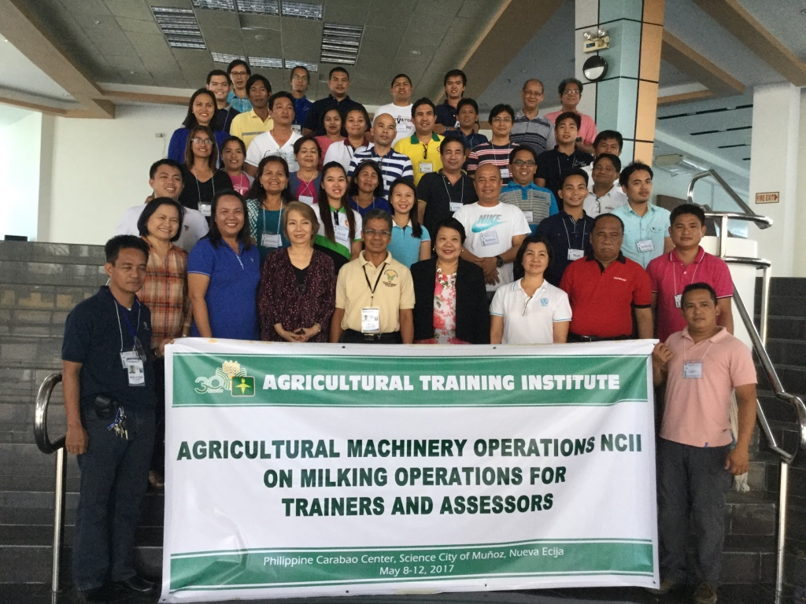
INSTITUTIONALIZED TRAINING PROGRAM THRU TESDA

Slide 23
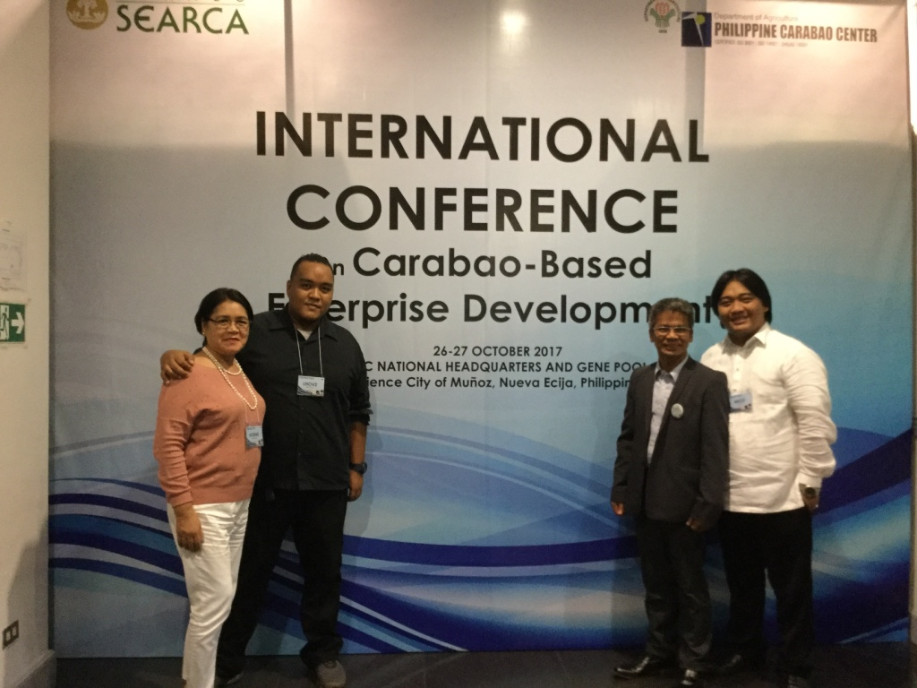
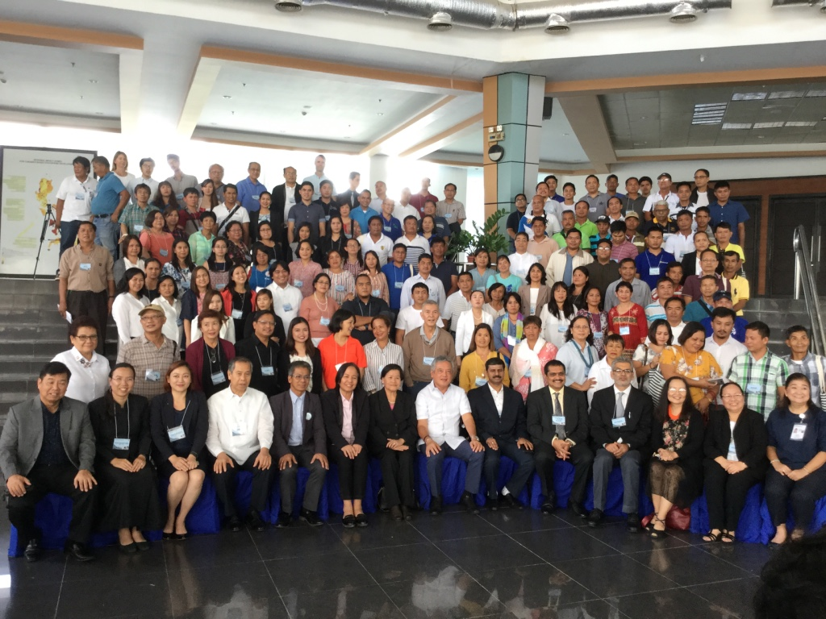
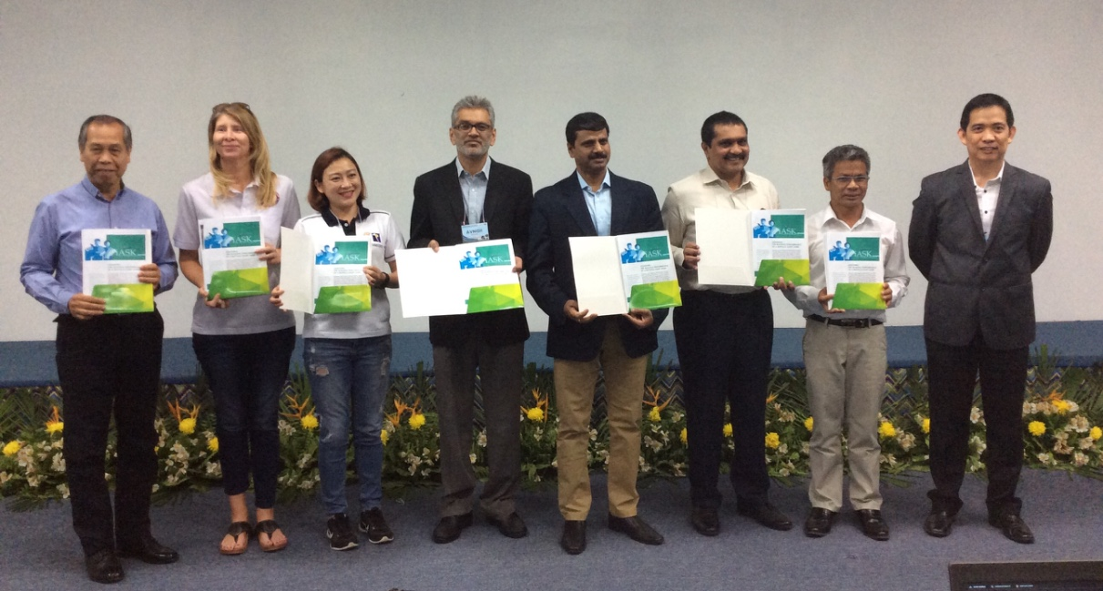
LEARNING FROM OUR BIG BROTHERS IN DAIRY AND MARKETING

Slide 24
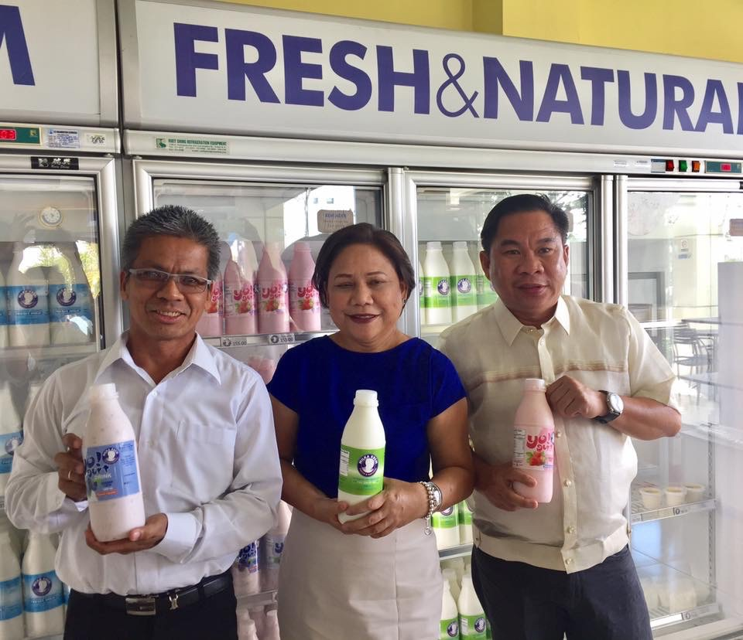
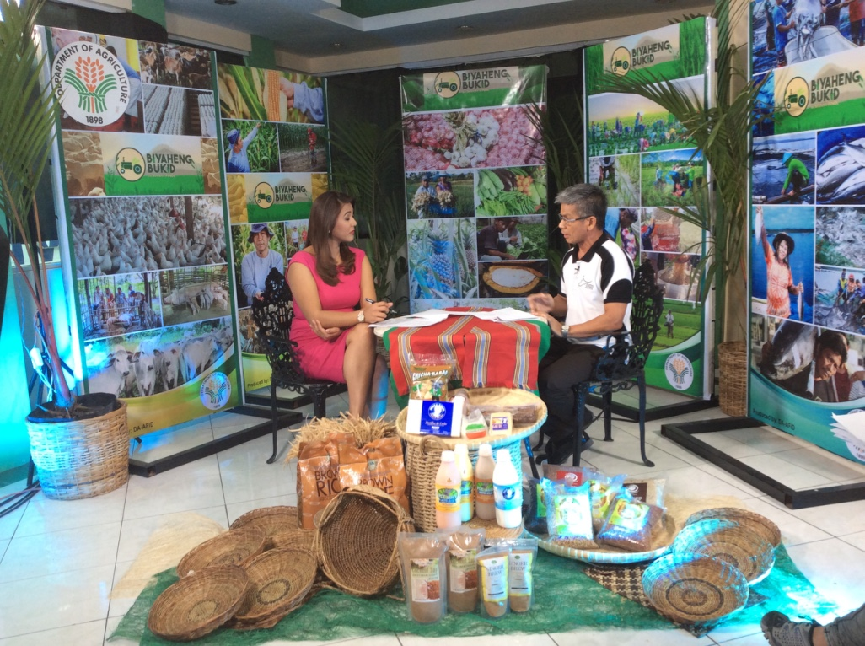
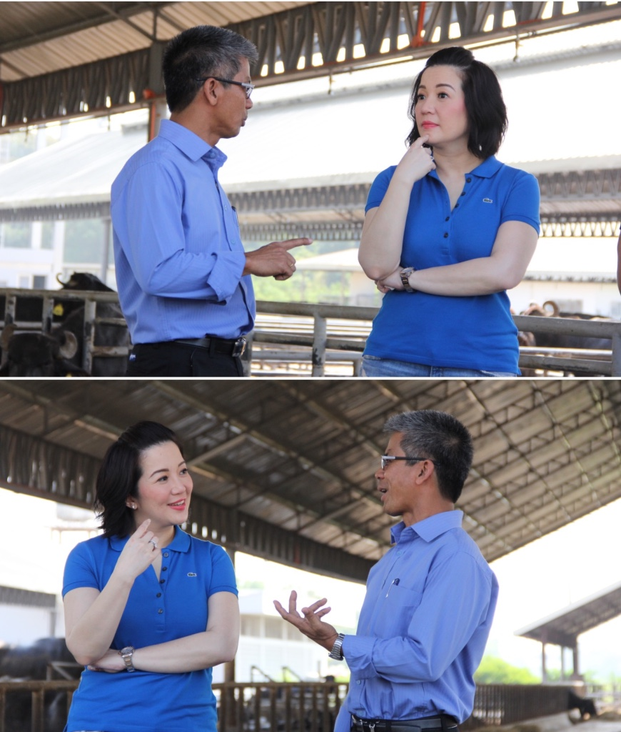
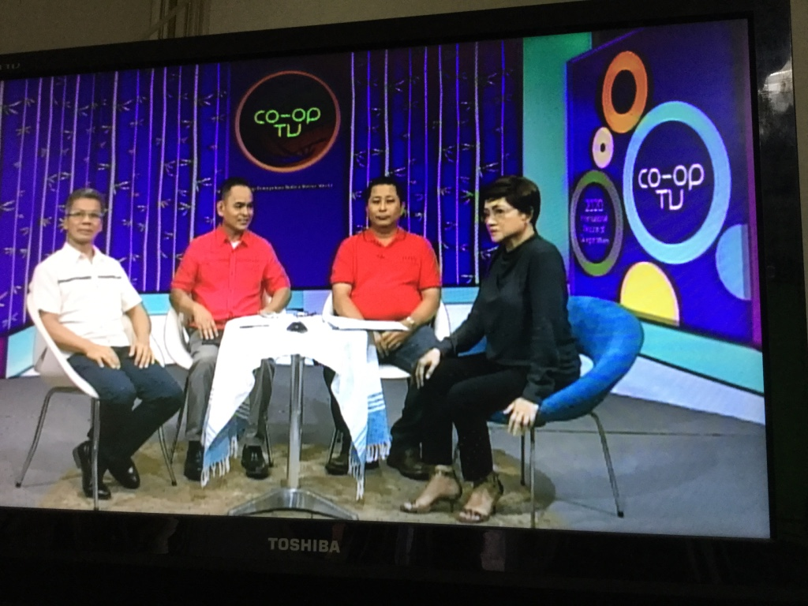
PROMOTION AND EDUCATION

Slide 25
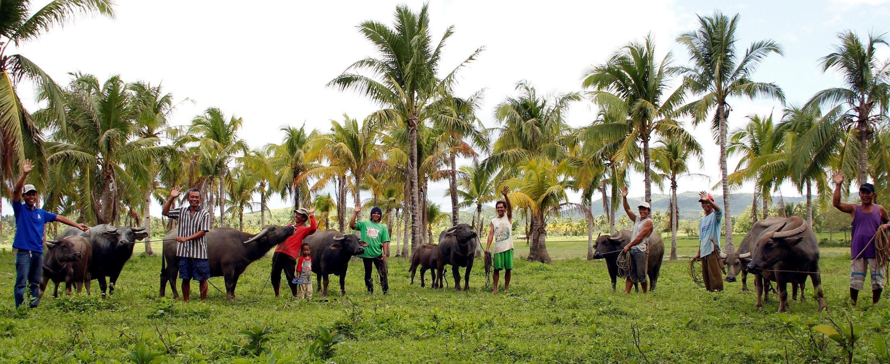
Thank you
PHILIPPINE CARABAO CENTER
NATIONAL HEADQUARTERS AND GENE POOL
Tel / Fax: +63 (44) 456-0730
Tels: +63 (44) 456-0731 to 32 and 34
Email: pcc-oed@mozcom.com
facebook @bubalus
Official Account: Philippine Carabao Center – Department of Agriculture
www.pcc.gov.ph

